Slide 1


Jason Forsythe
7/14/22

Slide 2

Outline
Executive Summary
Introduction
Methodology
Results
Conclusion
Appendix

Slide 3
Executive Summary
Summary of methodologies
Summary of all results

Slide 4
Introduction
In this project I wanted to find out the answers to a few questions
Can I predict the success of a SpaceX first stage landing?
If so, what parameters could be used to give the best prediction?
What would be the best accuracy of prediction that I could achieve?

Slide 5

Section 1

Slide 6
Methodology
Executive Summary
Data collection methodology:
Data was collected via SpaceX API and Web Scraping https://github.com/Jason-AE/IBM_Data_Science/tree/master/DataCollectionAPI
Perform data wrangling
Once Data was collected, I removed unesseary columns and replaced null values. https://github.com/Jason-AE/IBM_Data_Science/tree/master/DataWrangling
Perform exploratory data analysis (EDA) using visualization and SQL
Perform interactive visual analytics using Folium and Plotly Dash
Perform predictive analysis using classification models
I tested Logistic Regression, Vector Machine, Tree, and K Nearest Neighbor models using grid search to find the best parameters for each. I then compared the results using test data and the Tree model performed the best. https://github.com/Jason-AE/IBM_Data_Science/tree/master/PredictiveAnalysis

Slide 7
Data Collection – SpaceX API
Data was collected using SpaceX’s own Web API
https://api.spacexdata.com/v4/launches/past
This data was used along with different endpoints to combine data about the rockets, launchpads, payloads, and cores.
The Data was then stored in a Panda’s Data Frame
Rockets
Pandas Dataframe
Past Launches
Launchpads
Payloads
Cores
https://github.com/Jason-AE/IBM_Data_Science/tree/master/DataCollectionAPI

Slide 8
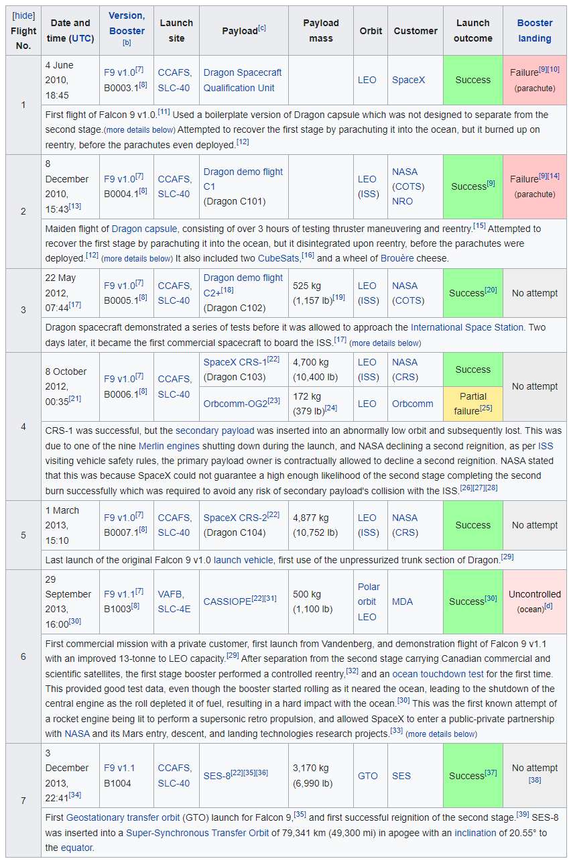
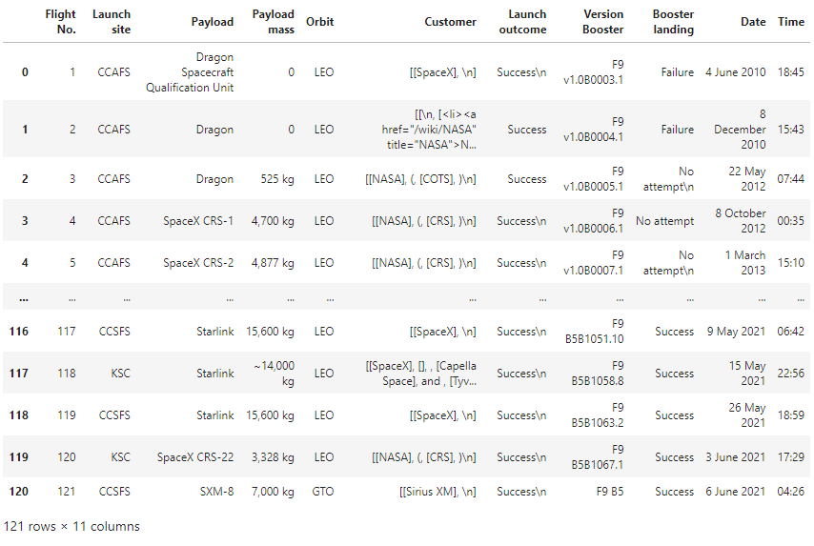
Data Collection - Scraping
Data was also collected using Web scrapping using Wikipedia data in HTML Tables https://en.wikipedia.org/w/index.php?title=List_of_Falcon_9_and_Falcon_Heavy_launches&oldid=1027686922
BeautifulSoup Library Was Used to Extract Data
Helper functions cleaned the HTML
Pandas Dataframe was created
Iterations over the rows was used to fill Dataframe
Resulting Pandas Dataframe
HTML Table Example
https://github.com/Jason-AE/IBM_Data_Science/tree/master/DataCollectionAPI

Slide 9
Data Wrangling
Once data was collected it needs to be cleaned
Check for missing values in each attribute (~40 in LandingPad)
Replace missing values with mean in that column or remove rows
Convert landing outcomes to a class of either 0 failed 1 success
Now we can check the mean of success (66.666%)
This clean up is important for normalization and predictive analytics (to be preformed later)
https://github.com/Jason-AE/IBM_Data_Science/tree/master/DataWrangling

Slide 10
EDA with Data Visualization
In Exploratory Data Analysis I plotted the following charts:
Success rate vs launch site: to determine if launch site affects success
Flight number per site vs success rate: to determine if launches were more successful with later launches.
Payload per site vs success rate: to determine if payload affects success rate at each site
Success rate vs orbit type: to determine if orbit affects success rate
Payload by orbit type vs success rate: to determine if certain payloads in a give orbit affect success rate
Success rate over time (yearly): to determine if success increased over time
https://github.com/Jason-AE/IBM_Data_Science/tree/master/EDA

Slide 11
EDA with SQL
In exploratory data analysis using SQL I performed the following queries:
Select distinct launch site names
Displayed 5 records from the data set where the launch site contained ‘KSC’
Displayed the total payload carried for NASA missions
Displayed the average payload carried by booster version F9 v1.1
Showed the date of the first successful landing on a drone ship
Listed the names of the boosters that have had successful landings on land with a mass greater than 4000 and less that 6000 kg
Listed the total number of successful and failure mission outcomes
Listed the booster versions that have carried the maximum payload mass
For 2017 listed the booster versions and launch sites for successful landings on land
Ranked the count of successful landings between 2010-06-04 and 2017-03-20 in descending order
https://github.com/Jason-AE/IBM_Data_Science/tree/master/EDA

Slide 12
Build an Interactive Map with Folium
I built a Folium Interactive Map to show the relation of launch sites and successful landings at each in a more visual way
I used a folium.Circle object to mark the area of the launch site with details
I also used a folium.map.Marker to mark a launch site when zoomed out
I made markers of green and red to represent successful or failed launches
Lastly, I made marker clusters to group successful and failed launches based on launch sites
https://github.com/Jason-AE/IBM_Data_Science/tree/master/FoliumMap

Slide 13
Build a Dashboard with Plotly Dash
I created an interactive dashboard with plotly with the following features:
Pie chart showing success rate per launch site
Scatter plot showing launch outcomes vs payload colored by booster version
Launch site dropdown that includes all sites (Controls data for pie and scatter chart)
Payload range slider (controls data for scatter chart only)
https://github.com/Jason-AE/IBM_Data_Science/tree/master/Capstone_Mod3_Interactive_Dashboard

Slide 14
Predictive Analysis (Classification)
During predictive Analysis I test the following models:
Logistic Regression
Vector Machine
Tree
K Nearest Neighbor
I used grid search to find the best parameters for each.
I then compared the results using test data and the Tree model performed the best. https://github.com/Jason-AE/IBM_Data_Science/tree/master/PredictiveAnalysis

Slide 15
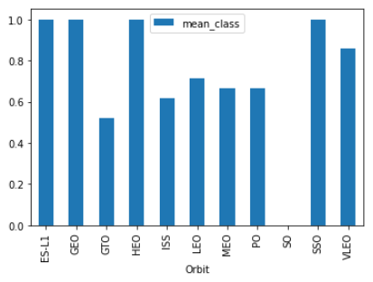
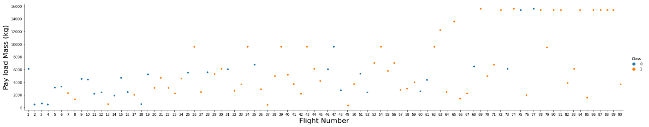
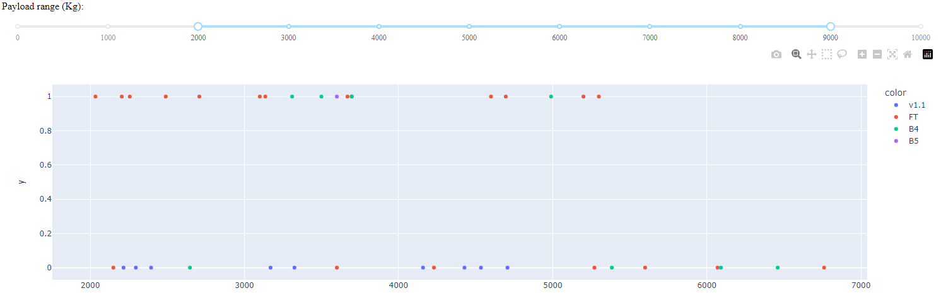
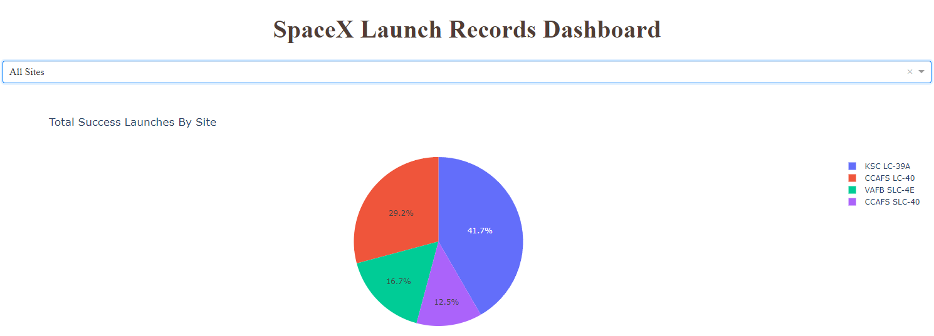
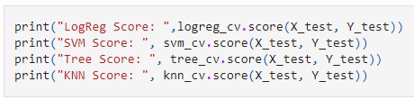
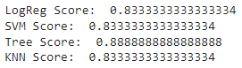
Results
I found that Orbit, Launch Site, Payload, and Flight Number are good predictors of success.
Interactive analytics demo in screenshots
Predictive analysis results

Slide 16

Section 2

Slide 17
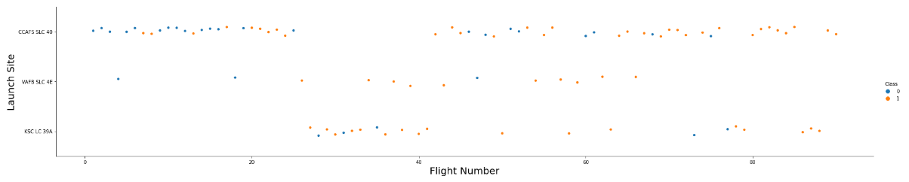
Flight Number vs. Launch Site
Scatter plot of Flight Number vs. Launch Site
Launch Sites on the Y axis and Flight Number on the X axis, Blue dots are failed landings and Orange dots are successful landings.
You can see that KSC LC-39A has the best record of success
Additionally, you can see CCAFS SLC 40 has improved its success over time

Slide 18
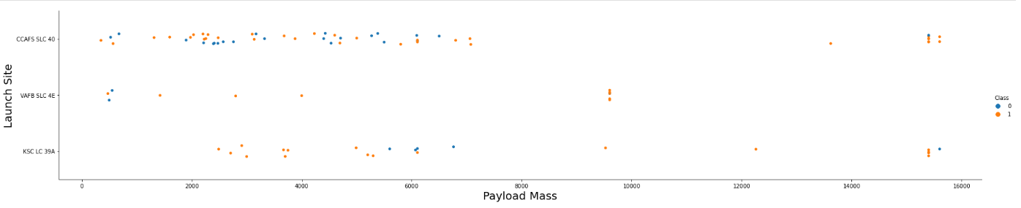
Payload vs. Launch Site
Scatter plot of Payload vs. Launch Site
CCAF5 SLC 40 has a better track record with heavier payload
VAFB SLC 4E’s failures happed with very light payloads
Most success has happened with payloads from 8000 to16000 kg

Slide 19
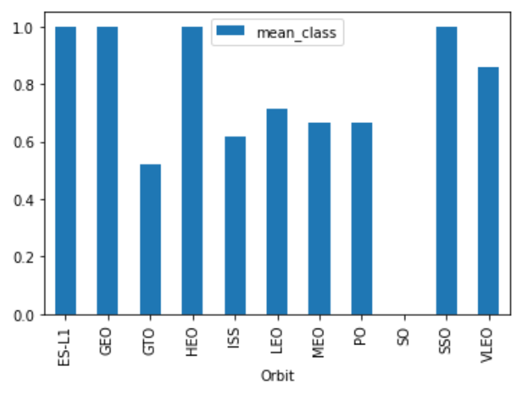
Success Rate vs. Orbit Type
Bar chart for the success rate of each orbit type
ESL1, GEO, HEO, and SSO have 100% success
VLEO is close second with 90% success
LEO is in third with 70% success
GTO performed the worse with 50% success
Imagine flipping a coin to see if your multi million-dollar rocket would land!

Slide 20
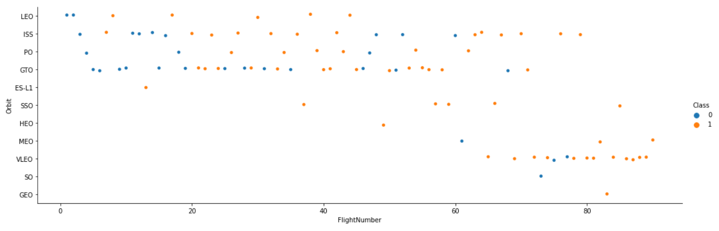
Flight Number vs. Orbit Type
Scatter point of Flight number vs. Orbit type
First few launches were in LEO and ISS orbits and failed
Launches in LEO and ISS orbits had a better success rate with time
VLEO, SO, GEO, where only attempted later in the program

Slide 21
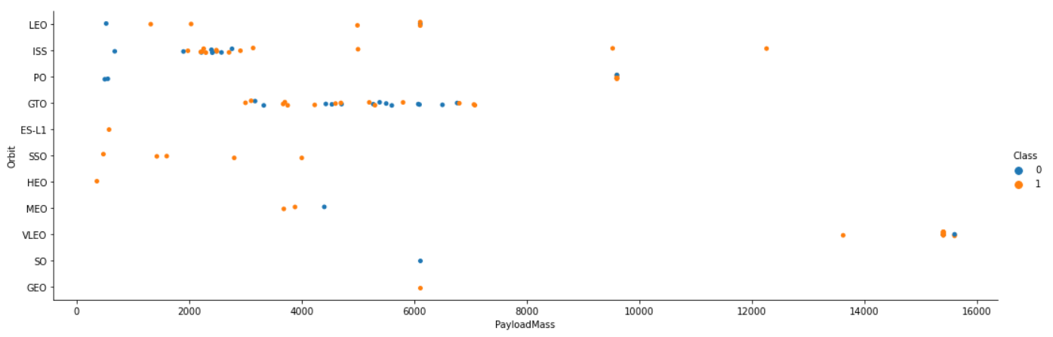
Payload vs. Orbit Type
Scatter point of payload vs. orbit type
GTO orbit landing success does not seem to be tied to payload mass
ES-L1, SSO, HEO, and MEO launches took place with less than 7000kg of payload
VLEO launches saw the highest payload masses of the program

Slide 22
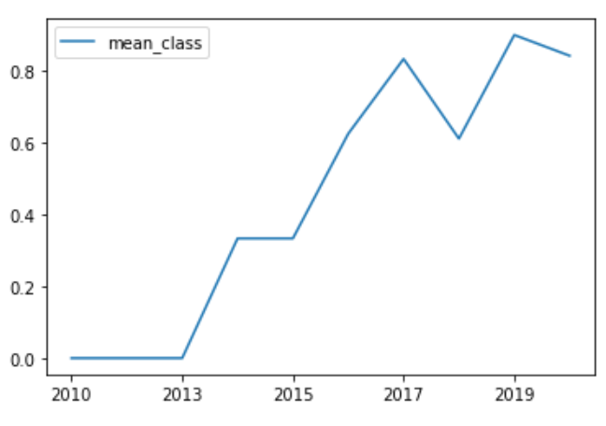
Launch Success Yearly Trend
Line chart of yearly average success rate
The SpaceX program started in 2010
In 2015 the success rate was less than 40%
2017 the success rate jumped to over 80%
There was a slight dip in success in 2018
2019 rebounded with a nearly perfect landing success rate

Slide 23
All Launch Site Names
In the data set there are four unique launch sites
CCAFS LC-40
CCAFS SLC-40
KSC LC-39A
VAFB SLC-4E
select distinct(LAUNCH_SITE) FROM SPACEXTBL
The above query returns the distinct launch sites from the data set.

Slide 24
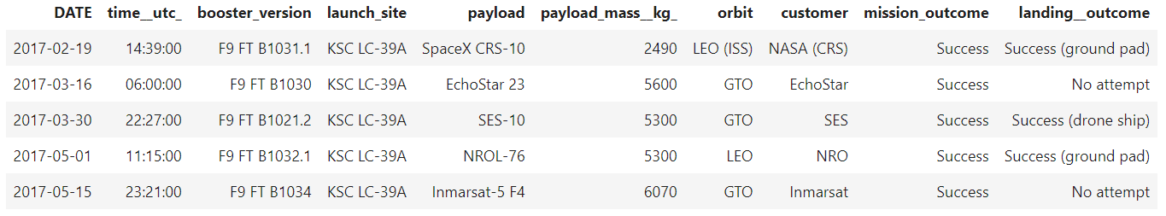
Launch Site Names Begin with 'KSC'
SELECT * FROM SPACEXTBL WHERE LAUNCH_SITE LIKE 'KSC%' limit 5
Here are 5 records of launches from launch sites that start with KSC

Slide 25
Total Payload Mass
select sum(payload_mass__kg_) from spacextbl where customer = 'NASA (CRS)’
The above query sums the total payload mass of all rockets where the customer was NASA
The total payload is 45,596 kg

Slide 26
Average Payload Mass by F9 v1.1
select avg(payload_mass__kg_) from spacextbl where booster_version = 'F9 v1.1’
The above query calculates the average payload carried by F9 v1.1 boosters
The average payload is 2,928 kg for the F9 v1.1 boosters

Slide 27
First Successful Ground Landing Date
select min(date) from spacextbl where landing__outcome = 'Success (drone ship)’
The above query finds the first date that SpaceX performed a successful drone ship landing
That date was 04-08-2016

Slide 28
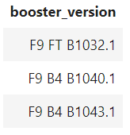
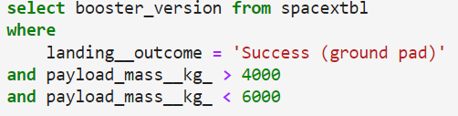
Successful Drone Ship Landing with Payload between 4000 and 6000
The above images show the query to get the booster version that have landed on a drone ship that launched with more than 4,000kg of payload and less than 6,000kg of payload.

Slide 29
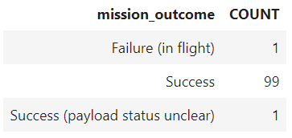
Total Number of Successful and Failure Mission Outcomes
select mission_outcome, count(*) as count from spacextbl group by mission_outcome
The above query retrieves the counts of the different mission outcomes (this is not the same as landing outcomes of the booster)

Slide 30
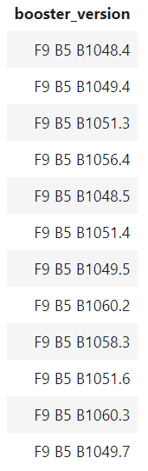
Boosters Carried Maximum Payload
select booster_version from spacextbl where payload_mass__kg_ = (select max(payload_mass__kg_) from spacextbl)
The above query retrives the booster versions that have carried the maximum payload. It uses a sub query in the predicate to get the max payload.

Slide 31
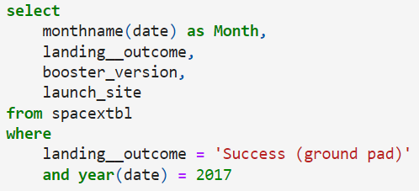
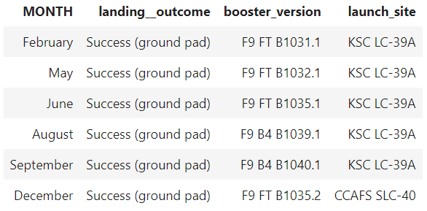
2017 Launch Records
The above images show the query and successful landings on ground
The columns where specifically selected to give a summary

Slide 32
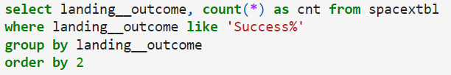
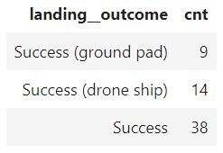
Rank Landing Outcomes Between 2010-06-04 and 2017-03-20
The above images show the query and the successful landings ranked by landing outcome
Group by must be used when an aggregate function is used such as count(*)

Slide 33

Section 3

Slide 34
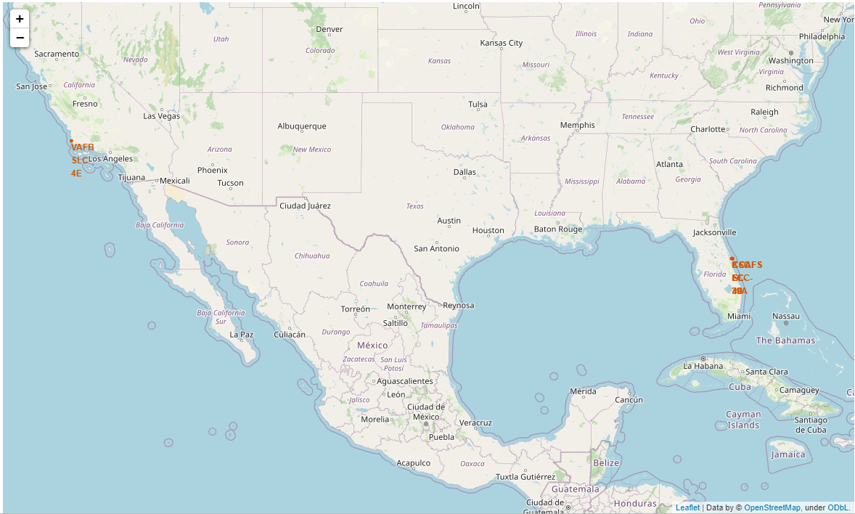
Map of Launch Sites
I found that all SpaceX launch sites are located on either the West or East Cost of the United States of America

Slide 35
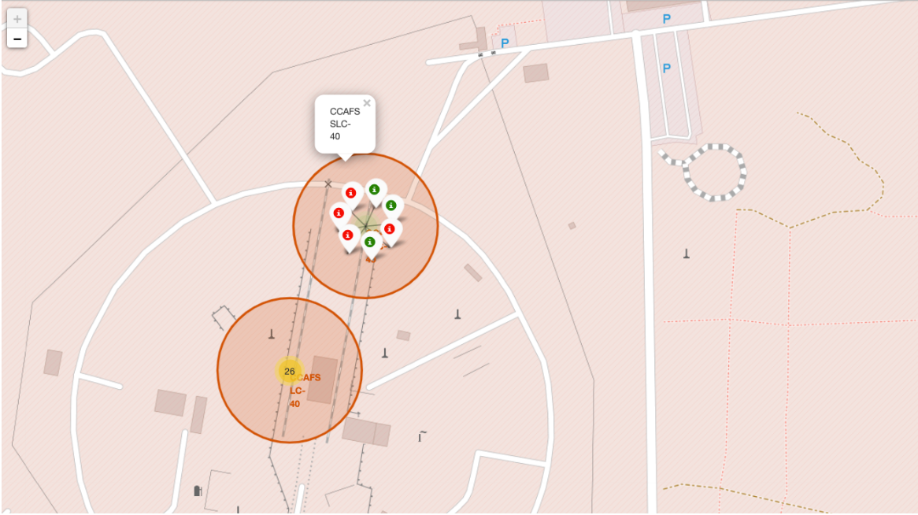
Colored Labels Based On Landing Success
Clustering multiple records and coloring them based on landing success can give more details on a map then if we placed all icons on the exact position of the launch

Slide 36
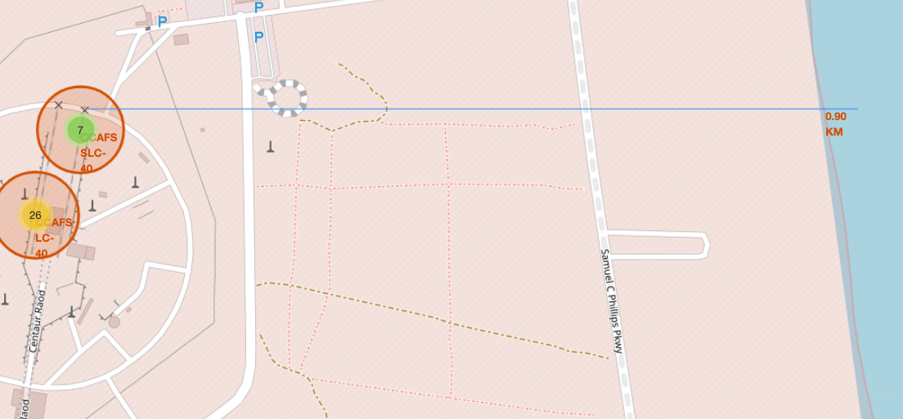
Launch Sites and Proximities
I found it interesting that launch sites seem to be in extremely close proximity to railroads. Most likely to transport rockets and supplies.
I also noticed that launch sites seem to avoid crossing major highways on their short path over the ocean, in some cases less then 1 km away.

Slide 37

Section 4

Slide 38
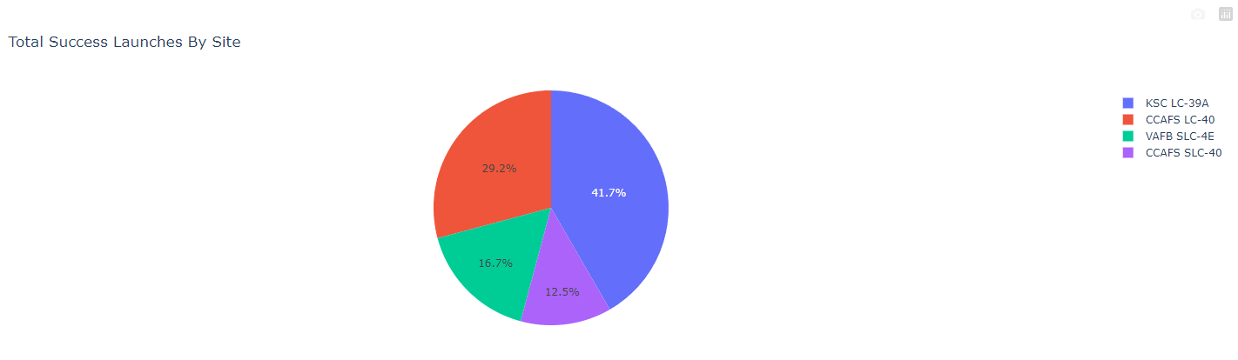
Successful Landings for all Sites
KSC LC-39A was the most successful of all the sites
CCAFS LC-40 was second
CCAFS SLC-40 was the least successful

Slide 39
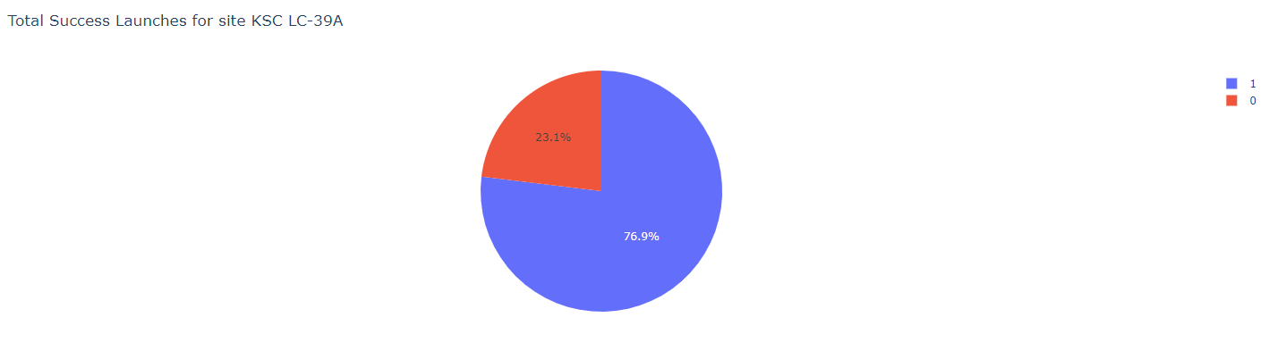
Most Successful Launch Site
KSC LC-39A was the most successful launch site
About 77% of launches ended with a successful landing
Only about 23% of launched boosters failed to land

Slide 40
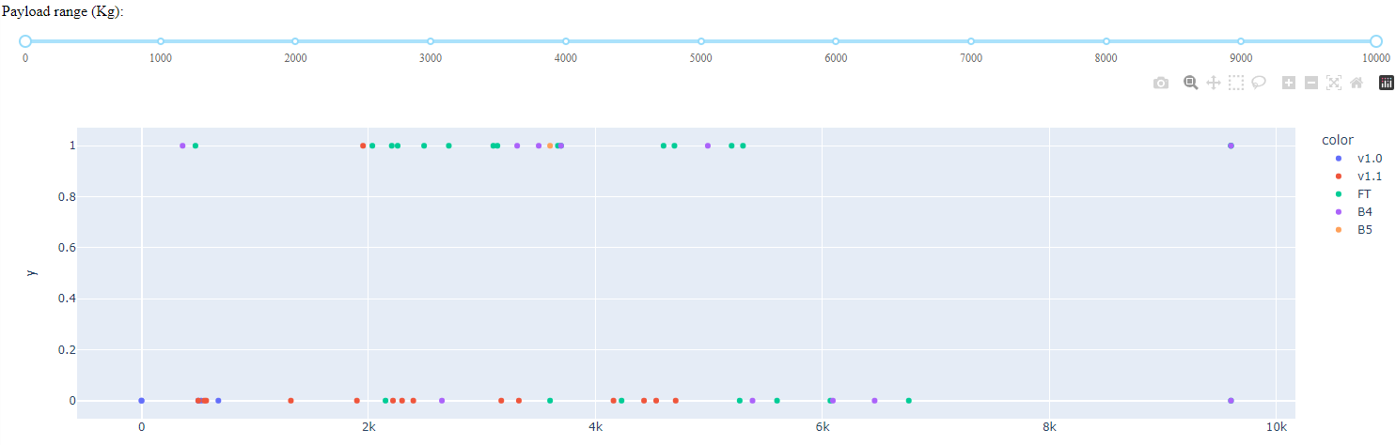
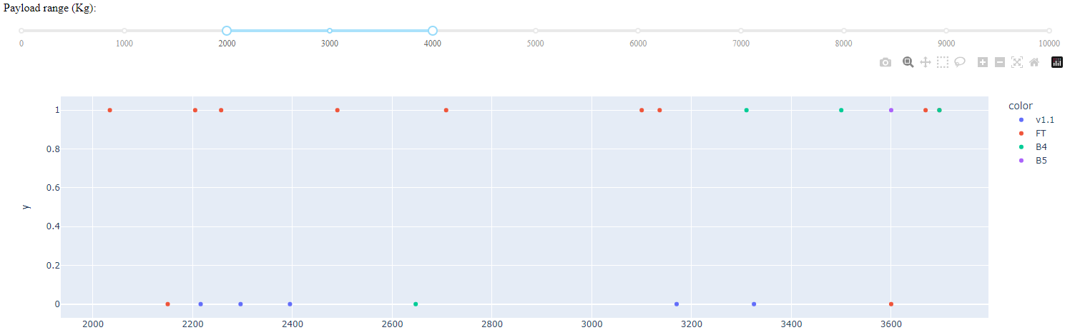
Launch Success vs Payload
Launch success for all sites and payloads
A mix of success and failure can be seen
Launch success for all sites and payload between 2,000 and 4,000 kg
This was the most successful range of payloads

Slide 41

Section 5

Slide 42
Classification Accuracy
The Tree Model preformed the best when the test data was applied.
Greater than 88% accuracy could be achieved using the tree model

Slide 43
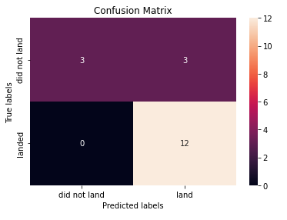
Tree Confusion Matrix
While the tree model performed the best in my case it isn’t perfect.
The tree was good at predicting successful landings getting 12 correct and 3 incorrect.
The tree was bad at predicting failed landings, it miss all three failures.

Slide 44
Conclusions
Successful landings can be predicted with a limited number of false positives and false negatives
Launch sites, payload, flight number, and orbit are good predicting factors
Predictions could improve with a larger sample of known outcomes
Models vary in predictive accuracy
Predictions could improve with data sets specific to the one of the predicting factors. Such as models made per Launch Site, Payload, Orbit etc.

Slide 45


